Slide 1
Last time: A driving example: Beobots
Goal: build robots that can operate in unconstrained environments and that can solve a wide variety of tasks.
We have:
  Lots of CPU power
  Prototype robotics platform
  Visual system to find interesting objects in the world
  Visual system to recognize/identify some of these objects
  Visual system to know the type of scenery the robot is in
We need to:
  Build an internal representation of the world
  Understand what the user wants
  Act upon user requests / solve user problems

Slide 2
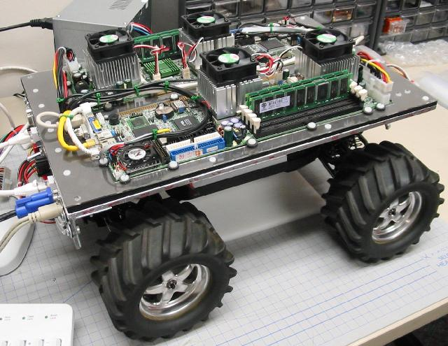
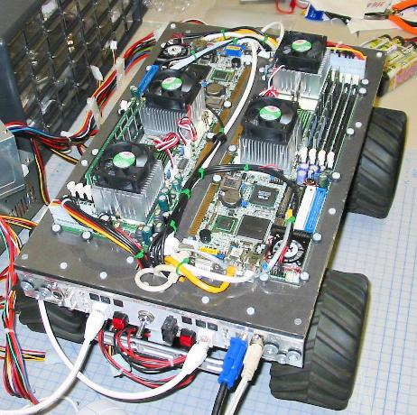
Beowulf + Robot =
“Beobot”

Slide 3
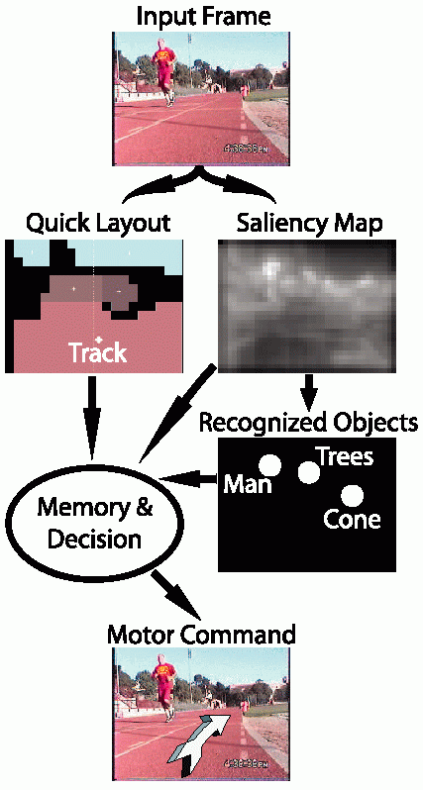
Prototype
Stripped-down version of proposed
general system, for simplified
goal: drive around USC olympic
track, avoiding obstacles
Operates at 30fps on quad-CPU
Beobot;
Layout & saliency very robust;
Object recognition often confused
by background clutter.

Slide 4
Major issues
How to represent knowledge about the world?
How to react to new perceived events?
How to integrate new percepts to past experience?
How to understand the user?
How to optimize balance between user goals & environment constraints?
How to use reasoning to decide on the best course of action?
How to communicate back with the user?
How to plan ahead?
How to learn from experience?

Slide 5
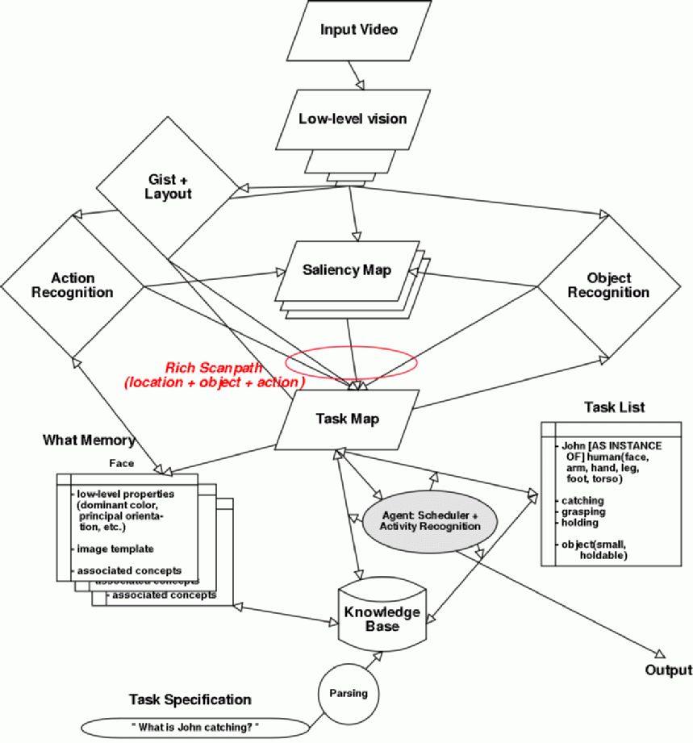
General architecture

Slide 6
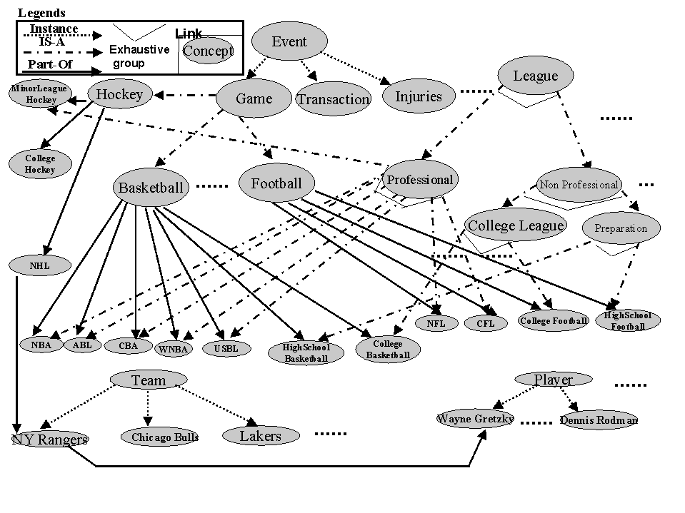
Ontology
Khan & McLeod, 2000

Slide 7
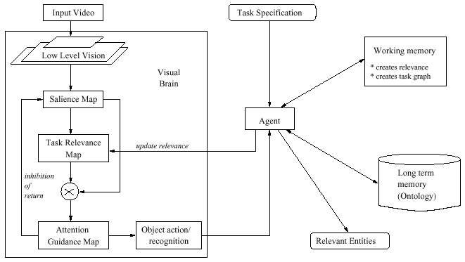
The task-relevance map
Navalpakkam & Itti, BMCV’02
Scalar topographic map, with higher values at more relevant locations

Slide 8
More formally: how do we do it?
Use ontology to describe categories, objects and relationships:
Either with unary predicates, e.g., Human(John),
Or with reified categories, e.g., John ∈ Humans,
And with rules that express relationships or properties,
e.g., ∀x Human(x) ⇒ SinglePiece(x) ∧ Mobile(x) ∧ Deformable(x)
Use ontology to expand concepts to related concepts:
E.g., parsing question yields “LookFor(catching)”
Assume a category HandActions and a taxonomy defined by
catching ∈ HandActions, grasping ∈ HandActions, etc.
We can expand “LookFor(catching)” to looking for other actions in the category where catching belongs through a simple expansion rule:
∀a,b,c a ∈ c ∧ b ∈ c ∧ LookFor(a) ⇒ LookFor(b)

Slide 9
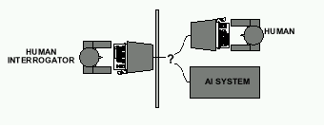
Last Time: Acting Humanly: The Full Turing Test
Alan Turing's 1950 article Computing Machinery and Intelligence discussed conditions for considering a machine to be intelligent
  “Can machines think?” ←→ “Can machines behave intelligently?”
  The Turing test (The Imitation Game): Operational definition of intelligence.
Computer needs to posses:Natural language processing, Knowledge representation, Automated reasoning, and Machine learning
Problem: 1) Turing test is not reproducible, constructive, and amenable to mathematic analysis. 2) What about physical interaction with interrogator and environment?
Total Turing Test: Requires physical interaction and needs perception and actuation.

Slide 10
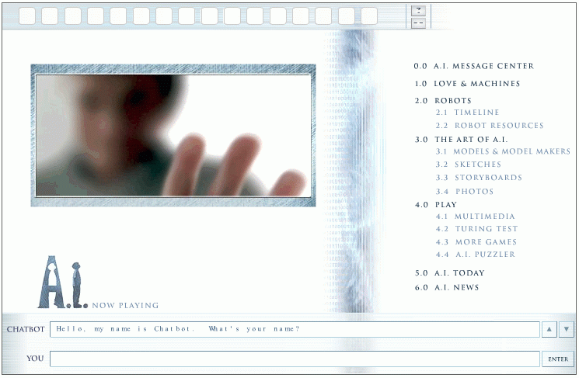
Last time: The Turing Test
http://aimovie.warnerbros.com
http://www.ai.mit.edu/projects/infolab/

Slide 11

Last time: The Turing Test
http://aimovie.warnerbros.com
http://www.ai.mit.edu/projects/infolab/

Slide 12

Last time: The Turing Test
http://aimovie.warnerbros.com
http://www.ai.mit.edu/projects/infolab/

Slide 13

Last time: The Turing Test
http://aimovie.warnerbros.com
http://www.ai.mit.edu/projects/infolab/

Slide 14

Last time: The Turing Test
FAILED!
http://aimovie.warnerbros.com
http://www.ai.mit.edu/projects/infolab/

Slide 15
This time: Outline
Intelligent Agents (IA)
Environment types
IA Behavior
IA Structure
IA Types

Slide 16
What is an (Intelligent) Agent?
An over-used, over-loaded, and misused term.
Anything that can be viewed as perceiving its environment through sensors and acting upon that environment through its effectors to maximize progress towards its goals.
PAGE (Percepts, Actions, Goals, Environment)
Task-specific & specialized: well-defined goals and environment
The notion of an agent is meant to be a tool for analyzing systems, not an absolute characterization that divides the world into agents and non-agents. Much like, e.g., object-oriented vs. imperative program design approaches.

Slide 17
Intelligent Agents and Artificial Intelligence
Human mind as network of thousands or millions of agents all working in parallel. To produce real artificial intelligence, this school holds, we should build computer systems that also contain many agents and systems for arbitrating among the agents' competing results.
Distributed decision-making
and control
Challenges:
  Action selection: What next action
  to choose
  Conflict resolution
Agency
sensors
effectors

Slide 18
Agent Types
We can split agent research into two main strands:
Distributed Artificial Intelligence (DAI) –
Multi-Agent Systems (MAS) (1980 – 1990)
Much broader notion of "agent" (1990’s – present)
  interface, reactive, mobile, information

Slide 19
A Windshield Wiper Agent
How do we design a agent that can wipe the windshields when needed?
Goals?
Percepts ?
Sensors?
Effectors ?
Actions ?
Environment ?

Slide 20
A Windshield Wiper Agent (Cont’d)
Goals: To keep windshields clean and maintain good visibility
Percepts: Raining, Dirty
Sensors: Camera (moist sensor)
Effectors: Wipers (left, right, back)
Actions: Off, Slow, Medium, Fast
Environment: US inner city, freeways, highways, weather …

Slide 21

Towards Autonomous Vehicles
http://iLab.usc.edu
http://beobots.org

Slide 22
Interacting Agents
Collision Avoidance Agent (CAA)
Goals: Avoid running into obstacles
Percepts ?
Sensors?
Effectors ?
Actions ?
Environment: Freeway
Lane Keeping Agent (LKA)
Goals: Stay in current lane
Percepts ?
Sensors?
Effectors ?
Actions ?
Environment: Freeway

Slide 23
Interacting Agents
Collision Avoidance Agent (CAA)
Goals: Avoid running into obstacles
Percepts: Obstacle distance, velocity, trajectory
Sensors: Vision, proximity sensing
Effectors: Steering Wheel, Accelerator, Brakes, Horn, Headlights
Actions: Steer, speed up, brake, blow horn, signal (headlights)
Environment: Freeway
Lane Keeping Agent (LKA)
Goals: Stay in current lane
Percepts: Lane center, lane boundaries
Sensors: Vision
Effectors: Steering Wheel, Accelerator, Brakes
Actions: Steer, speed up, brake
Environment: Freeway

Slide 24
Conflict Resolution by Action Selection Agents
Override: CAA overrides LKA
Arbitrate: if Obstacle is Close then CAA
else LKA
Compromise: Choose action that satisfies both
agents
Any combination of the above
Challenges: Doing the right thing

Slide 25
The Right Thing = The Rational Action
Rational Action: The action that maximizes the expected value of the performance measure given the percept sequence to date
  Rational = Best ?
  Rational = Optimal ?
  Rational = Omniscience ?
  Rational = Clairvoyant ?
  Rational = Successful ?

Slide 26
The Right Thing = The Rational Action
Rational Action: The action that maximizes the expected value of the performance measure given the percept sequence to date
  Rational = Best Yes, to the best of its knowledge
  Rational = Optimal Yes, to the best of its abilities (incl. its constraints)
  Rational ≠ Omniscience
  Rational ≠ Clairvoyant
  Rational ≠ Successful

Slide 27
Behavior and performance of IAs
Perception (sequence) to Action Mapping: f : P* → A
  Ideal mapping: specifies which actions an agent ought to take at any point in time
  Description: Look-Up-Table vs. Closed Form
Performance measure: a subjective measure to characterize how successful an agent is (e.g., speed, power usage, accuracy, money, etc.)
(degree of) Autonomy: to what extent is the agent able to make decisions and actions on its own?

Slide 28
How is an Agent different from other software?
Agents are autonomous, that is they act on behalf of the user
Agents contain some level of intelligence, from fixed rules to learning engines that allow them to adapt to changes in the environment
Agents don't only act reactively, but sometimes also proactively
Agents have social ability, that is they communicate with the user, the system, and other agents as required
Agents may also cooperate with other agents to carry out more complex tasks than they themselves can handle
Agents may migrate from one system to another to access remote resources or even to meet other agents

Slide 29
Environment Types
Characteristics
  Accessible vs. inaccessible
  Deterministic vs. nondeterministic
  Episodic vs. nonepisodic
  Hostile vs. friendly
  Static vs. dynamic
  Discrete vs. continuous

Slide 30
Environment types
Environment | Accessible | Deterministic | Episodic | Static | Discrete
Operating System
Virtual Reality
Office Environment
Mars

Slide 31
Environment types
Environment | Accessible | Deterministic | Episodic | Static | Discrete
Operating System | Yes | Yes | No | No | Yes
Virtual Reality | Yes | Yes | Yes/No | No | Yes/No
Office Environment | No | No | No | No | No
Mars | No | Semi | No | Semi | No
The environment types largely determine the agent design.

Slide 32
Structure of Intelligent Agents
Agent = architecture + program
Agent program: the implementation of f : P* → A, the agent’s perception-action mapping
function: Skeleton-Agent(Percept) returns Action
memory ← UpdateMemory(memory, Percept)
Action ← ChooseBestAction(memory)
memory ← UpdateMemory(memory, Action)
return Action
Architecture: a device that can execute the agent program (e.g., general-purpose computer, specialized device, beobot, etc.)

Slide 33
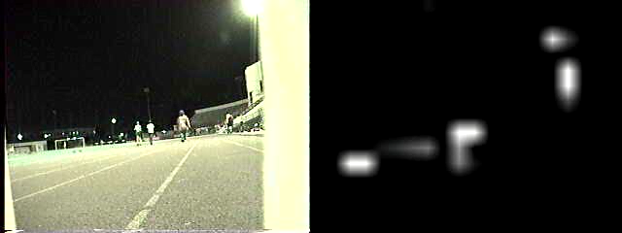
Using a look-up-table to encode f : P* → A
Example: Collision Avoidance
  Sensors: 3 proximity sensors
  Effectors: Steering Wheel, Brakes
How to generate?
How large?
How to select action?
obstacle
sensors
agent

Slide 34
Using a look-up-table to encode f : P* → A
Example: Collision Avoidance
  Sensors: 3 proximity sensors
  Effectors: Steering Wheel, Brakes
How to generate: for each p ∈ P_{l} × P_{m} × P_{r}
generate an appropriate action, a ∈ S × B
How large: size of table = #possible percepts times # possible actions = |P_{l} | |P_{m}| |P_{r}| |S| |B|
E.g., P = {close, medium, far}³
A = {left, straight, right} × {on, off}
then size of table = 27*3*2 = 162
How to select action? Search.
obstacle
sensors
agent

Slide 35
Agent types
Reflex agents
Reflex agents with internal states
Goal-based agents
Utility-based agents

Slide 36
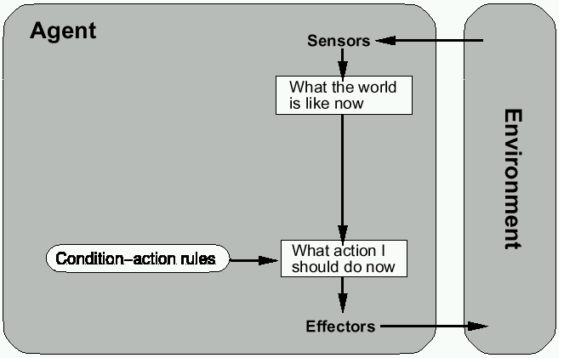
Reflex agents

Slide 37
Reactive agents
Reactive agents do not have internal symbolic models.
Act by stimulus-response to the current state of the environment.
Each reactive agent is simple and interacts with others in a basic way.
Complex patterns of behavior emerge from their interaction.
Benefits: robustness, fast response time
Challenges: scalability, how intelligent?
and how do you debug them?

Slide 38
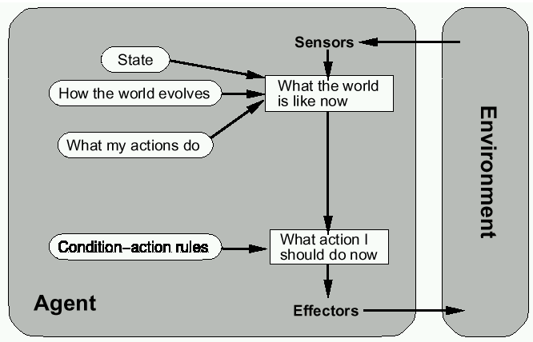
Reflex agents w/ state

Slide 39
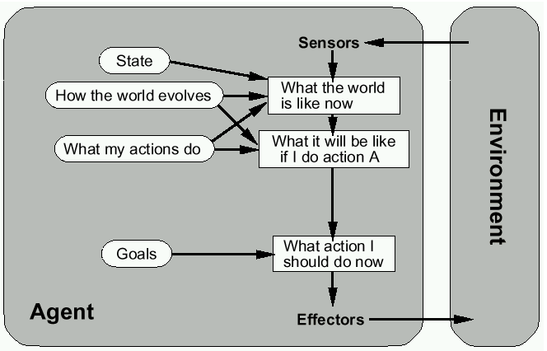
Goal-based agents

Slide 40
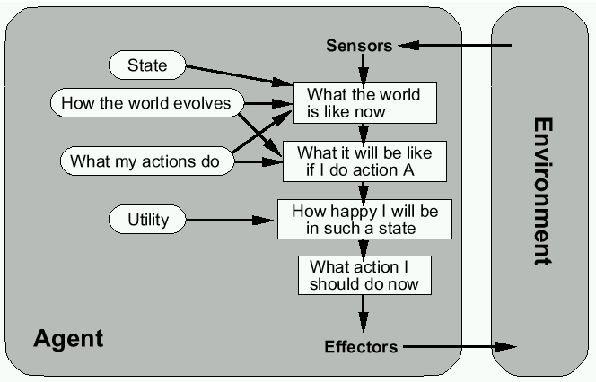
Utility-based agents

Slide 41
Mobile agents
Programs that can migrate from one machine to another.
Execute in a platform-independent execution environment.
Require agent execution environment (places).
Mobility not necessary or sufficient condition for agenthood.
Practical but non-functional advantages:
  Reduced communication cost (eg, from PDA)
  Asynchronous computing (when you are not connected)
Two types:
  One-hop mobile agents (migrate to one other place)
  Multi-hop mobile agents (roam the network from place to place)
Applications:
  Distributed information retrieval.
  Telecommunication network routing.

Slide 42
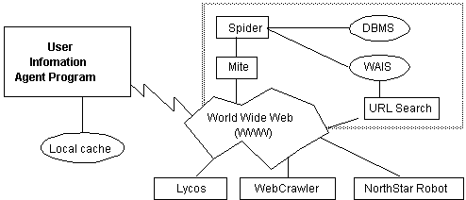
Information agents
Manage the explosive growth of information.
Manipulate or collate information from many distributed sources.
Information agents can be mobile or static.
Examples:
  BargainFinder comparison shops among Internet stores for CDs
  FIDO the Shopping Doggie (out of service)
  Internet Softbot infers which internet facilities (finger, ftp, gopher) to use and when from high-level search requests.
Challenge: ontologies for annotating Web pages (eg, SHOE).

Slide 43
Summary
Intelligent Agents:
  Anything that can be viewed as perceiving its environment through sensors and acting upon that environment through its effectors to maximize progress towards its goals.
  PAGE (Percepts, Actions, Goals, Environment)
  Described as a Perception (sequence) to Action Mapping: f : P* → A
  Using look-up-table, closed form, etc.
Agent Types: Reflex, state-based, goal-based, utility-based
Rational Action: The action that maximizes the expected value of the performance measure given the percept sequence to date

